Slide 1

Working with Audio Part 2 More Text-to-Speech

Slide 2
What We Will Cover
Understanding the TTS Object Model
Experimenting with Settings
More Experimenting with Settings
Trying to Make this Outline Look Good
Does It Make You Want to Subscribe?

Slide 3
Understanding the TTS Object Model

Slide 4
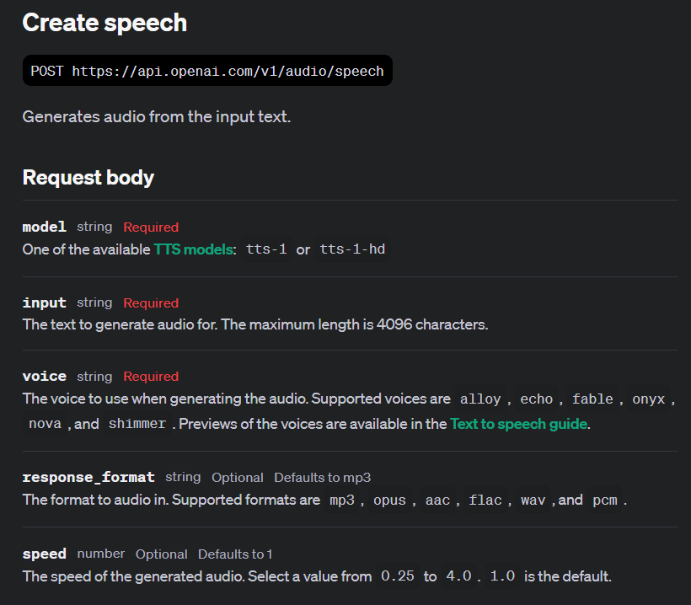
Notes:
https://platform.openai.com/docs/api-reference/audio/createSpeech

Slide 5
Demo: Experimenting with the Settings
# Define the speech file path
speech_file_path = "./experiments/fight_on_the_beaches.mp3"
# Create the TTS (Text-to-Speech) request
response = client.audio.speech.create(
model="tts-1", # Specify the TTS model to use
voice="fable", # Specify the voice to use for the TTS
response_format="mp3", # Specify the format of the response audio
speed=1.0, # Specify the speed of the TTS
input="""
We shall fight on the beaches, we shall fight on the landing grounds, we shall fight in the fields and in the streets, we shall fight in the hills; we shall never surrender.
""" # Input text to be converted to speech
)
# Save the response audio to a file
with open(speech_file_path, 'wb') as file:
file.write(response.content) # Write the audio content to the file
# Print a message indicating where the audio was saved
print(f"Audio saved to {speech_file_path}")

Slide 6



Notes:
https://www.youtube.com/channel/UC35ZpwldGw7ZJ5R-2sLijzw

Slide 7
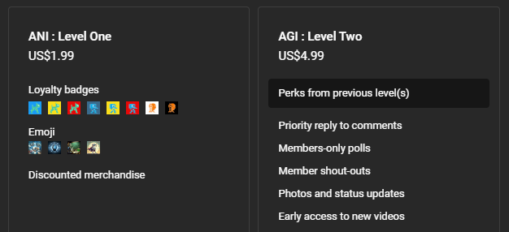

Membership has its privileges
Notes:
https://www.youtube.com/channel/UC35ZpwldGw7ZJ5R-2sLijzw/join

Slide 8

https://www.youtube.com/@AINewsFresh

Slide 9
